Slide 1
General Categories of Weaknesses (aspects)
Activity Flow
Performance
Roles

Slide 2


Taxonomy
Eventually Follows
Log
If a follow b in one or more steps in the same case
Tasks which can be run in parallel that the process allows
Back-loop
Parallelizable tasks
Series of activities occur in a repeated pattern as the process allows it.
Contains
Redundant Activity
Process
Instance of
Cases
Interface or media change
Activity that repeats as the process allows it
If the resource has changes for the same activity in the same case
Contains
Contains
Activity that took the maximum time across the log or in a case
If an activity is done by a resource who is not supposed to.
Activity
Instance of
Events
Bottle Neck
Incorrect resource/roles
Activity that is in forbidden list
Unutilized time between 2 events
Variance of Process Time
Idle time
Unwanted Activity
Min, Max, Average, Variance for each activity

Slide 3
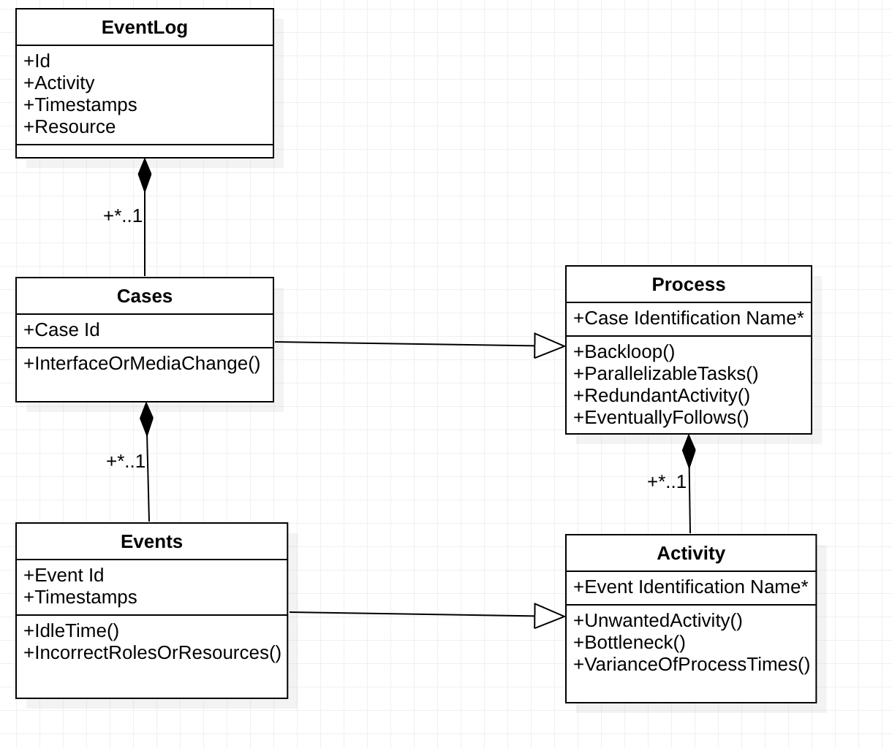
UML diagram for classifying the problems

Slide 4
Process
Start
Get the case(set of Events)
User Input of activities not to be followed say a, b
Is a is eventually followed by b?
Yes
List this case as violating EventuallyFollows
No
Do Series of activities occur in a repeated pattern as the process allows it?
Yes
List this case as violating the Backloop constraint
No
Does the process allow 2 tasks to be running independent of each other(Parallelly)?
Yes
List this case as violating the Parallellisable Task constraint
No
Dos the process allow redundant Activity?
Yes
List this case as violating the Redundant Activity constraint
No
Stop

Slide 5
Activity
Start
Get the activity
User Input of unwanted activities
Does a given activity is from unwanted activities?
Yes
List this activity as violating UnwantedActivity
No
Does the given activity cause the bottleneck ?(Compare the time taken for completion of a particular acitivity across all the activities)
Yes
List this activity as bottleneck activity
No
Does the process allow 2 tasks to be running independent of each other(Parallelly)?
Yes
List this case as violating the Parallellisable Task constraint
No
Calculate Min, Max, Average, Variance for each activity and list it out
Stop

Slide 6
Event
Start
Get the event
List of resources and their roles
Is the event performed by incorrect resource or resources with different roles ?
Yes
List this event as IncorrectResourceOrRoles
No
Calculate and list the idle times between 2 events
Stop

Slide 7
Case
Start
Get the case(set of Events)
Is there a interface or media change in this case?
Yes
List this case under InterfaceOrMediaChange
No
Stop

